Slide 1
Shell Bootcamp 2024 3 Reflections for Week 2
Aranyaa A Khatawate
Date : 30-Aug-2024

Slide 2
About Me
Some phrases that best describe me include:
Open-minded
Sociable
Confident
Grateful
Creative
Please share an image / visual that best represents you

Slide 3

My learnings from this week!

Slide 4
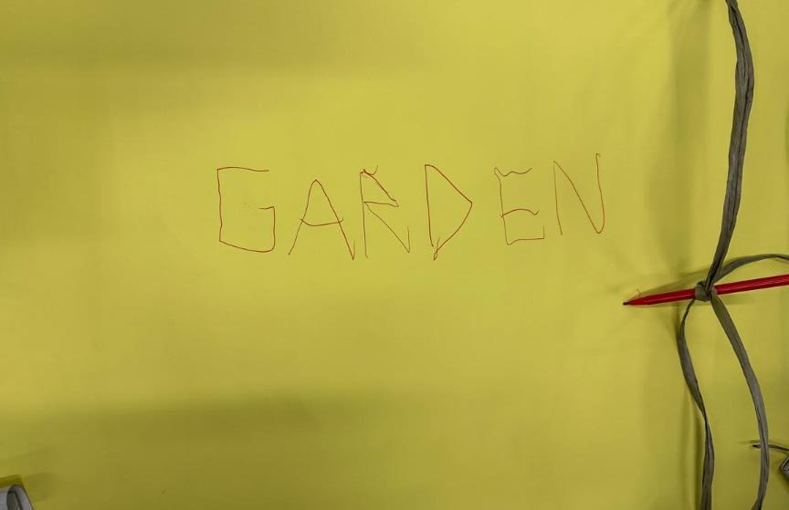
Learning 1 | My takeaways
First 3 days of soft skills emphasized on:
Growth mindset helps learn and grow
Importance of teamwork (An activity as shown)
Email etiquette (Power method)
Neuroplasticity allows us to learn new thing
Importance of grooming
Stages of team development
Presentation skills at work
Importance of pacing yourself at work
Importance of communication skills
[Add a graphic that provides evidence of what you learned]

Slide 5
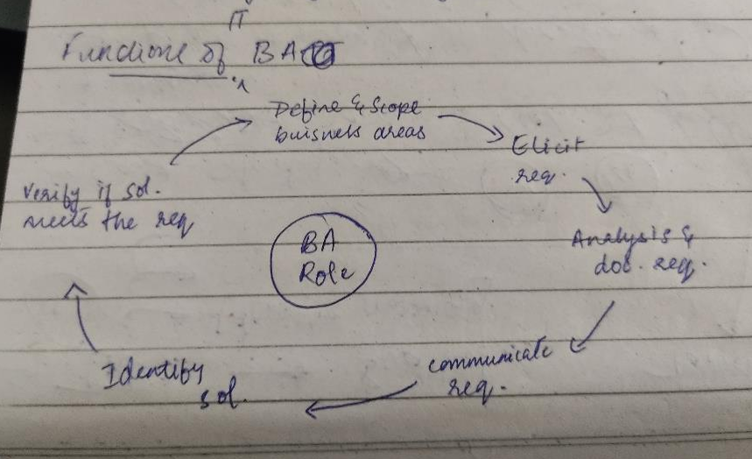
Learning 2 | My takeaways
The next 2 days focused on technical training.
1st day included:
Business Analyst and their roles and responsibilities
BRD – Business requirement document
SRS – Software requirement specification
Smart criteria
Elicitation techniques
Brainstorming, Interviews, Surveys, Prototyping, Document analysis
Requirement management – RTM (requirement traceability matrix)
Software project management – conflict management, release management, risk management, software configuration managemnt

Slide 6
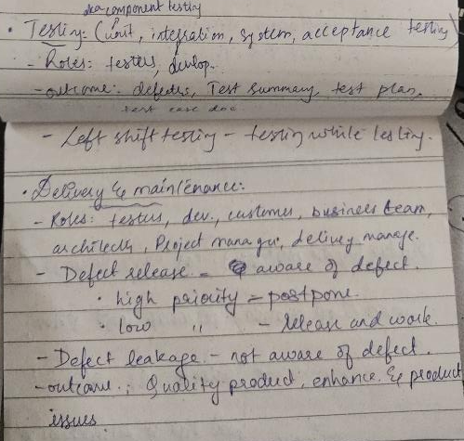
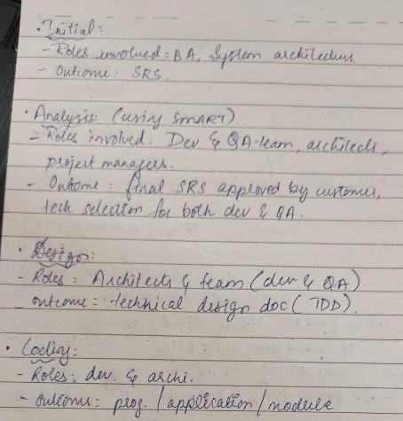
Learning 2 | My takeaways
The next 2 days focused on technical training.
1st day included:
Stages of deployment and release - Development env -> QA env -> Staging env -> Production env
Critical aspects of project management – planning, leading, execution, time management, budget, maintenance
Software development life cycle (SDLC) – phases include
Initial
Analysis
Design
Coding
Testing
Delivery and maintenance

Slide 7
Learning 3 | My takeaways
The next 2 days focused on technical training.
2nd day included:
Creating a BRD and SRS document with my team
Different models of SDLC
Waterfall
Vmodel
Prototype
Agile – project vision, epics, user stories, scrum teams and master, scrum artefacts, scrum ceremonies
All the images have been included in the next slide

Slide 8
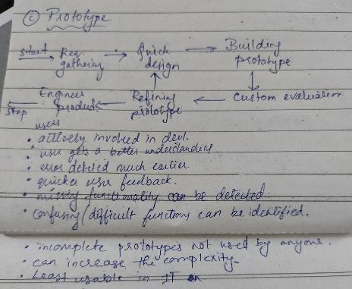
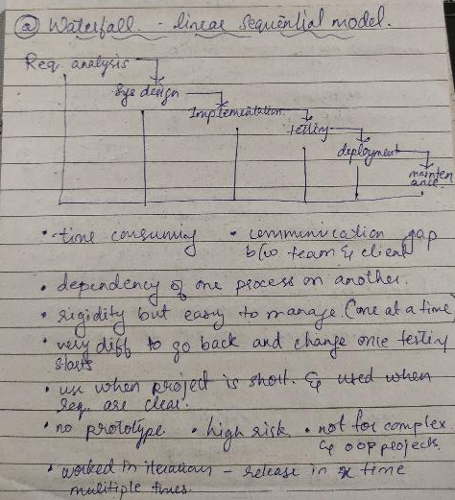
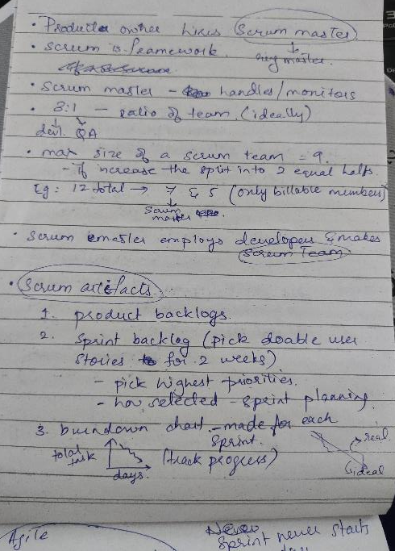
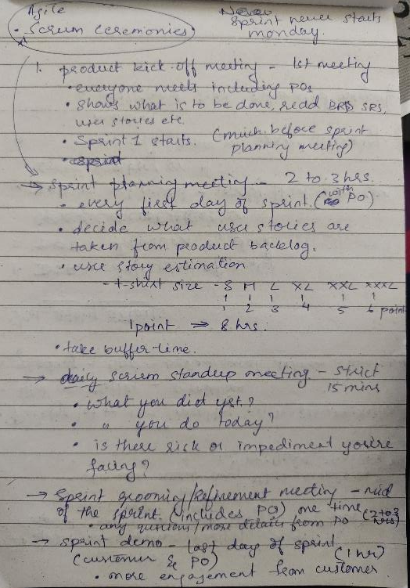
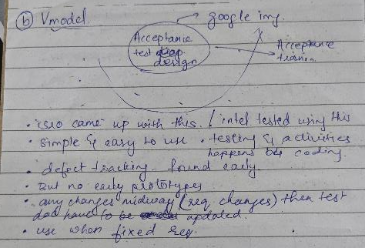
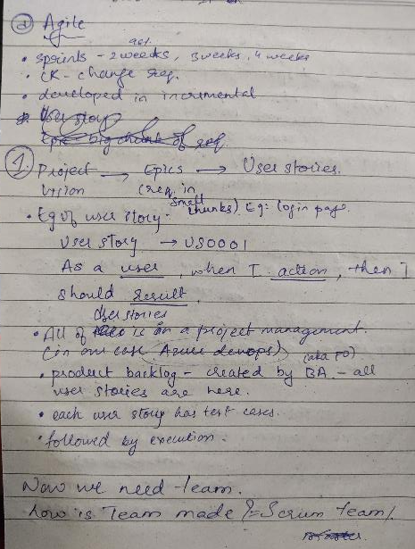
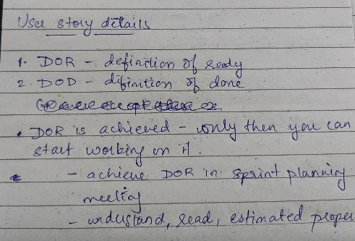
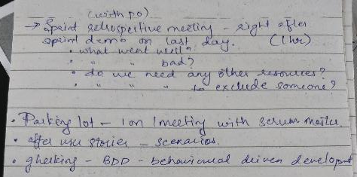

Slide 9

Relevance of learnings for my organization

Slide 10
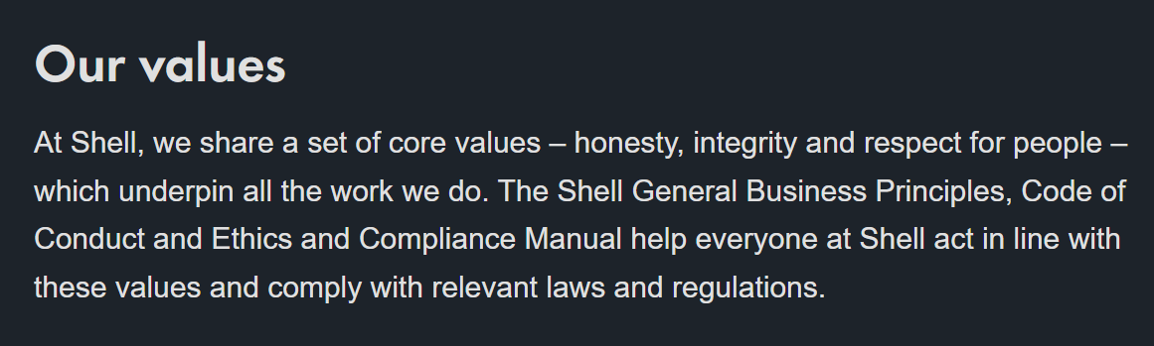
Learning 1 | Relevance for Shell
Soft skills is essential for any organization, including shell.
Teamwork and management of expectation is necessary
Hygiene and grooming is essential
Having a growth mindset allows us to learn more in the company
Email etiquette and presentation skills are a must in any company
These skills benefit both the company and its employees
[Add a graphic that provides view of how Shell implements this learning]
Shell core values incorporate these soft skills

Slide 11
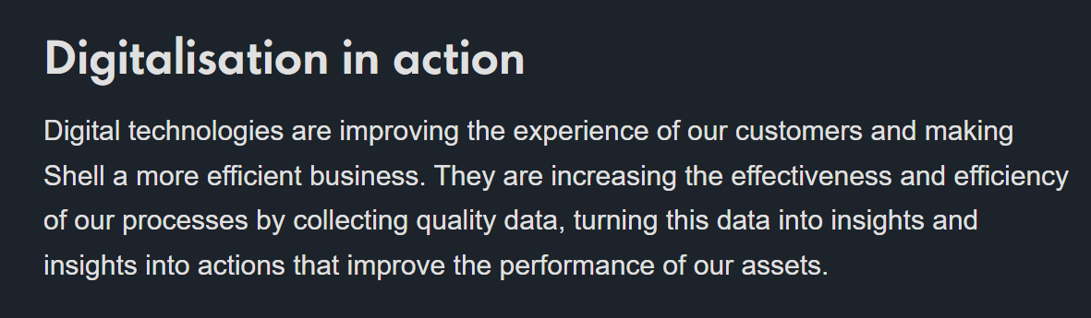
Learning 2 | Relevance for Shell
Having a strong foundation is essential before you start anything. The foundation training does the same.
Teaches us about the methods of implementation of software development. Every company needs a standard method that is followed to complete a project on time. SDLC teaches us AGILE which is used in shell to complete projects as per client requirement.
Shell benefits as well since the new employees are aware of the methods before getting into new projects
[Add a graphic that provides view of how Shell implements this learning]
Shells digitization goals need this foundation

Slide 12
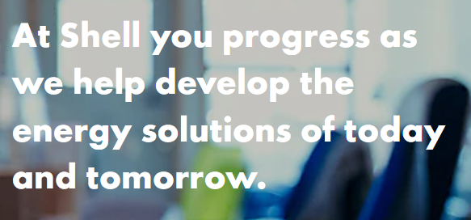
Learning 3 | Relevance for Shell
Business analysists play a major role in keeping shells business up and running. They are responsible for getting the clients for the organization.
Understanding the roles of a BA allows interested employees to gain understanding of how to become a BA for shell.
Shell also benefits from this as internal gob requitements allow the company to place employees who have experience and understanding of the company into more important roles like BA
[Add a graphic that provides view of how Shell implements this learning]

Slide 13

Challenges in implementing learning

Slide 14

Challenge faced while implementing Learning 1
There were not many challenges faced during the implementation of Learning 1. I was aware of most of the soft skills that were taught during this session.
Keeping a track of time is something that I need to remember to do. I tend to get carried away in the work that I am supposed to do
Looking back to the time / clock more often while working

Slide 15
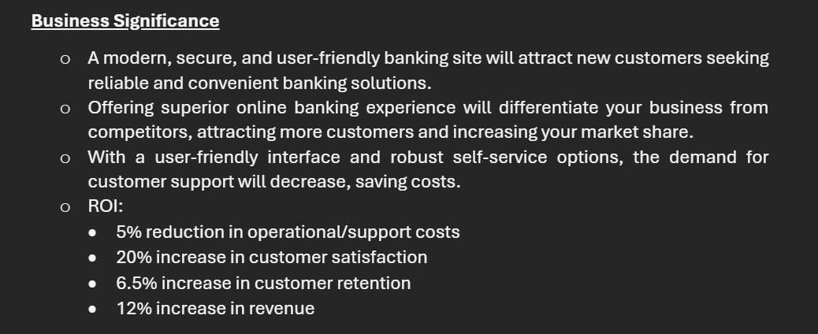
Challenge faced while implementing Learning 2
Creating a BRD and an SRS was a challenging task. In a short amount of time me and my team were able to put together the documents well, but we did miss out some of the points that are necessary to include in the BRD like:
Business significance
Bid type
Platform for the application
Changes were made to the document after feedback
[Add a graphic that provides evidence of what you did to overcome this challenge]

Slide 16

Challenge faced while implementing Learning 3
Another challenge was all the new terminologies with AGILE but it was made very easy by our trainer.
Making notes also helped.

Slide 17

Action Plan

Slide 18
My Action Plan for this Week
Actions
Timeline
Status
New learnings involved:
Understanding the role of a BA/ PO
Learning to write BRD and SRS documents
Elicitation techniques
Software development life cycle (SDLC)
Types of SDLC models
Complete the BRD and SRS documents in class with team assigned
Status – completed

Slide 19

Learning is also Fun!

Slide 20
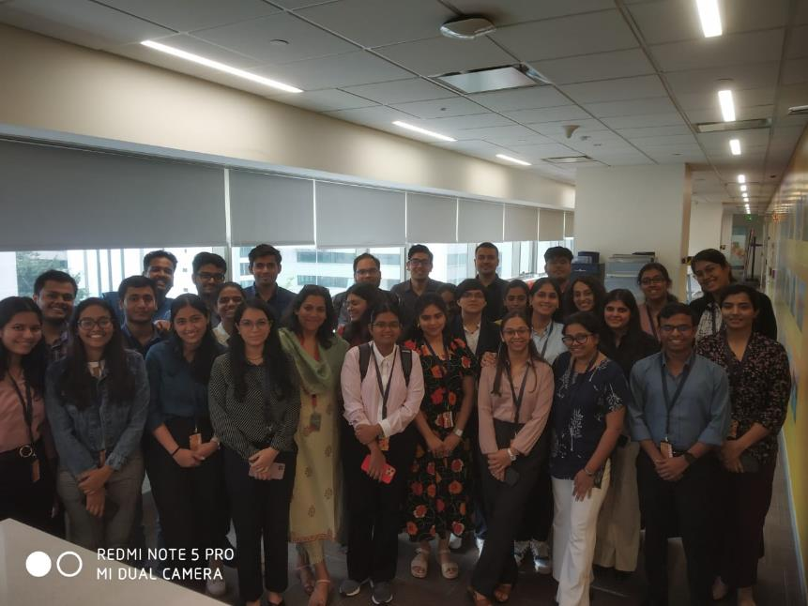
Learning is also Fun!
GARDEN – the word chosen for a fun team activity.
Role play for growth mindset which was hilarious, and we could not stop laughing during the presentation. Fun learning experience.
Interesting off topic/ off class discussions about life and lessons to be learnt.
Introduction of neighbor – had a good conversation with my neighbor.

Slide 21

Summary
The past week covered a lot of topics ranging from Soft skills like grooming, communication, mindset, teamwork to more technical yet foundational topics like SDLC architectures like waterfall, agile, vmodel, etc.
Topics coming up for the next week include software testing, devops, cloud, dbms and case work. All of which are essential for any technical role in the company.
These topics are the bricks after the foundation.
A good learning method is to revise what was taught on a day at the end of the session. Questions are also asked in case doubts arise.
Continue to take notes so it can be referred to later when required.
GitHub link: https://github.com/Aranyaa-k/UNext-Technical-Training.git

Slide 22
Thank You

